Slide 1
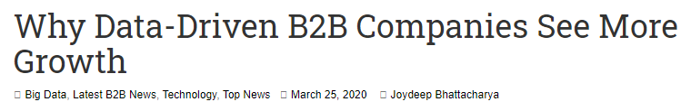

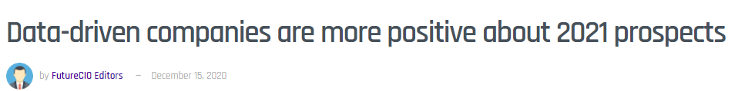
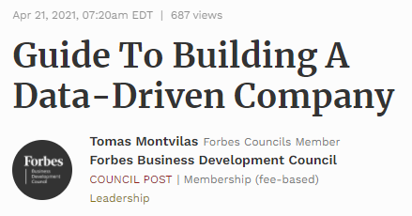
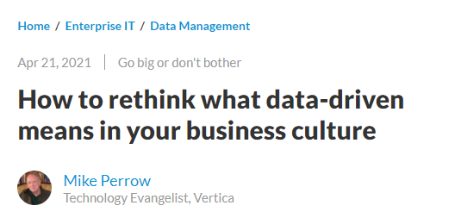

Slide 2

Data driven
Notes:
For a decision to be data-driven, it has to be the data — as opposed to something else entirely — that drive it. Seems so straightforward, and yet it’s so rare in practice because decision-makers lack a key psychological habit.
العربية الكارو محتاجة حمار عشان تبقى كارو
<number>

Slide 3

scenario
Notes:
Imagine that you are considering buying something online instead of making a pilgrimage to the other side of town to fetch it. You’ve boiled your decision down to whether or not you trust the online seller. A quick search yields some relevant data: you see that the seller has an average rating of 4.2 out of 5.
<number>

Slide 4
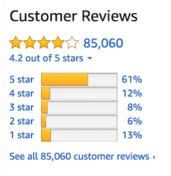
What u think?
Notes:
Now you can’t use that 4.2 to drive your decision. Game over! Once we’ve seen the answer, we’re free to pick the most convenient question. If the first thing we do is poke around in our data, our decision will be, at best, something I like to call data-inspired.
<number>

Slide 5
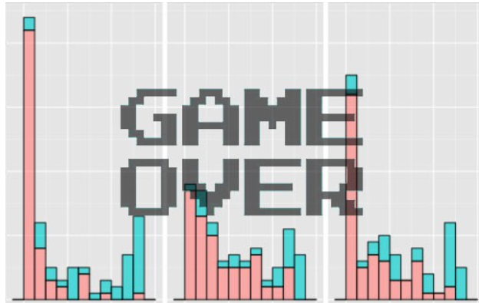
Data-drivenness destroyed
Any idea why?
Notes:
Once we’ve seen the answer, we’re free to pick the most convenient question
<number>

Slide 6
Data-drivenness destroyed
Once we’ve seen the
answer, we’re free to pick
the most convenient
question
Notes:
<number>

Slide 7
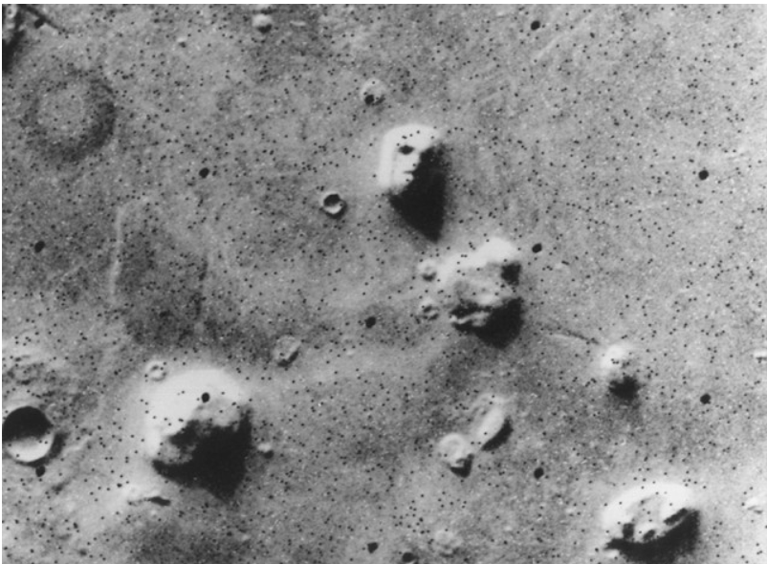

What u see, again?
12 sec shake?
Notes:
Satellite photo of the “Face on Mars” which many people took as evidence of extraterrestrial habitation.
How to know if there is indeed life on Mars? Test
How to know if 12 sec shake of ink can give u a butterfly image?
Retry
<number>

Slide 8
Notes:
Now you can’t use that 4.2 to drive your decision. Game over! Once we’ve seen the answer, we’re free to pick the most convenient question. If the first thing we do is poke around in our data, our decision will be, at best, something I like to call data-inspired.
<number>

Slide 9

Problem
How to solve?
Notes:
Problem: you’re free to move the goalposts after you find out where the data landed. (Of course you score a goal every time. You’re just that good.)
<number>

Slide 10
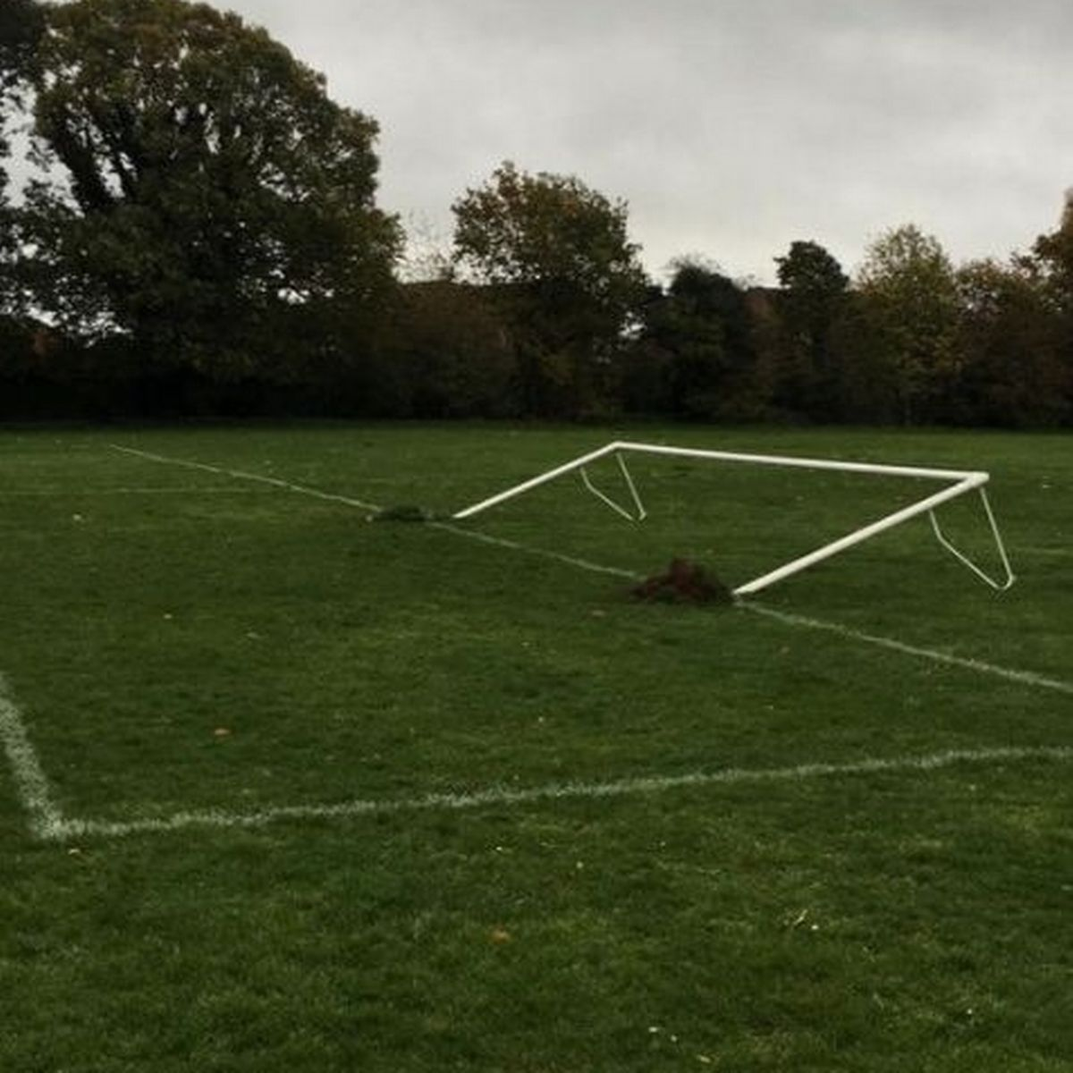

Solution
Notes:
set the goalposts in advance and resist temptation to move them later.
Framing the decision and setting decision criteria is a science of its own
a quick fix that goes a long way is to come up with your decision boundary up front in your data science project.
resis
<number>

Slide 11
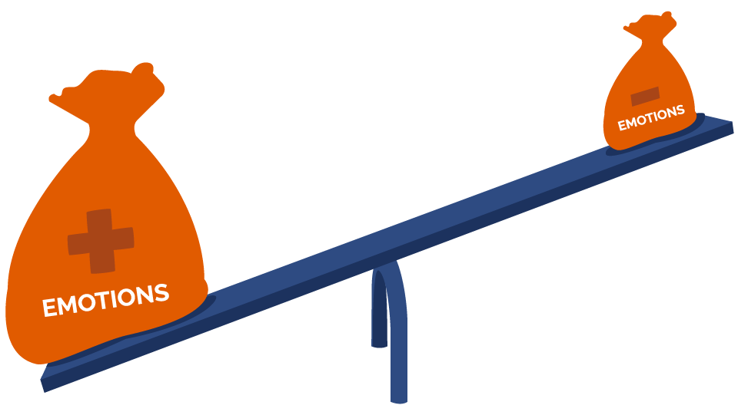

Notes:
That’s where we, like whales encountering plankton, swim around in some numbers, and then reach an emotional tipping point and… decide. There are numbers near our decision somewhere, but those numbers don’t drive it. The decision comes from somewhere else entirely.
<number>

Slide 12
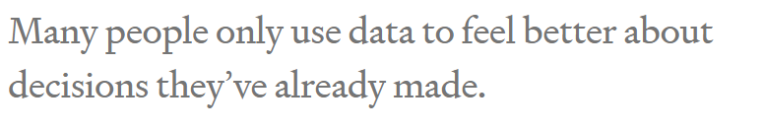
Notes:
<number>

Slide 13
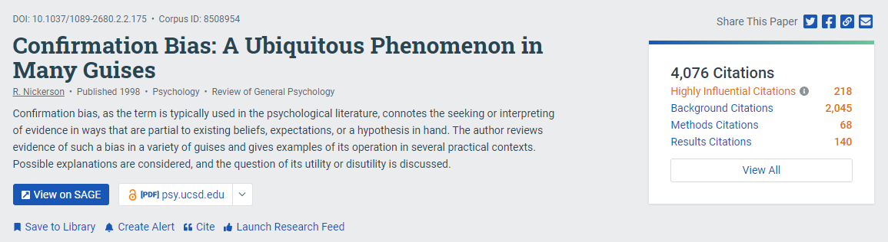
Notes:
The decision-maker’s mind was made up before the data, so the decision was there all along. Turns out humans interact with data selectively to confirm choices we’ve already made in our heart of hearts. We find the most convenient light in which to see evidence, and we don’t always know we’re doing it. Psychologists have a lovely name for this: confirmation bias.
<number>

Slide 14
Is it good?
Notes:
Positive
“It’s more than 4.0!”
They can even show a rigorous analysis about how it is statistically significantly higher than 4.0. (With certainty! It’s the p-value you’ve always wanted.)
Negative
“Why would I settle for a seller with less than 4.5 stars?” Or perhaps “But look at those 1-star reviews. I don’t like how many there are.” Sound familiar?
<number>

Slide 15
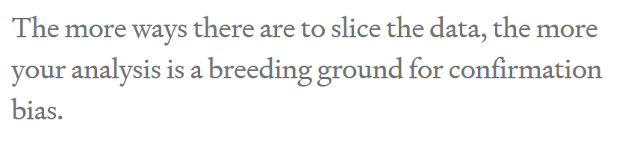

Slide 16

Solution
Notes:
Mathematical complexity doesn’t provide the antidote, it merely makes it harder to see the problem. As a result, what’s obvious in the trivial example we just saw becomes hidden in a jumble of gorgeous Gaussians. Don’t assume your friendly neighborhood data scientist sees it either. The more ways there are to slice the data, the more your analysis is a breeding ground for confirmation bias.
<number>

Slide 17
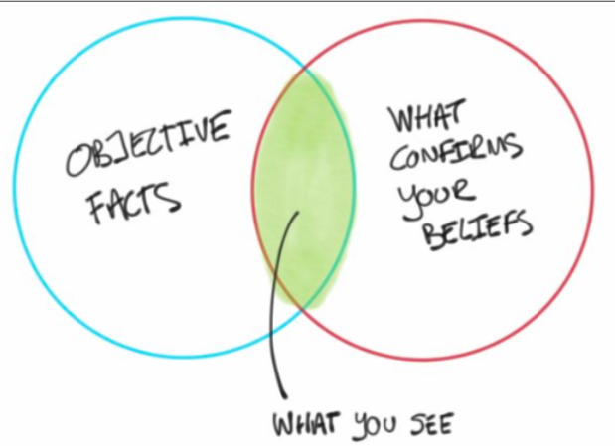
But why?

Slide 18

Notes:
feel better about doing what they were going to do anyway.
<number>

Slide 19


Any problem with real projects?
Notes:
It’s all about rating
What about a real pro
<number>

Slide 20



Expensive hobby

Slide 21

What’s the decision?
للأستاذة شيرين عبد الوهاب
Notes:
<number>

Slide 22

Notes:
When decision-makers lack fundamental skills, there’s no math in the world that can fix it. Your data science team will not contribute to data-driven decision-making.
<number>

Slide 23

What if?
Notes:
nothing would be different if all those poor data scientists just made some numbers up
<number>

Slide 24
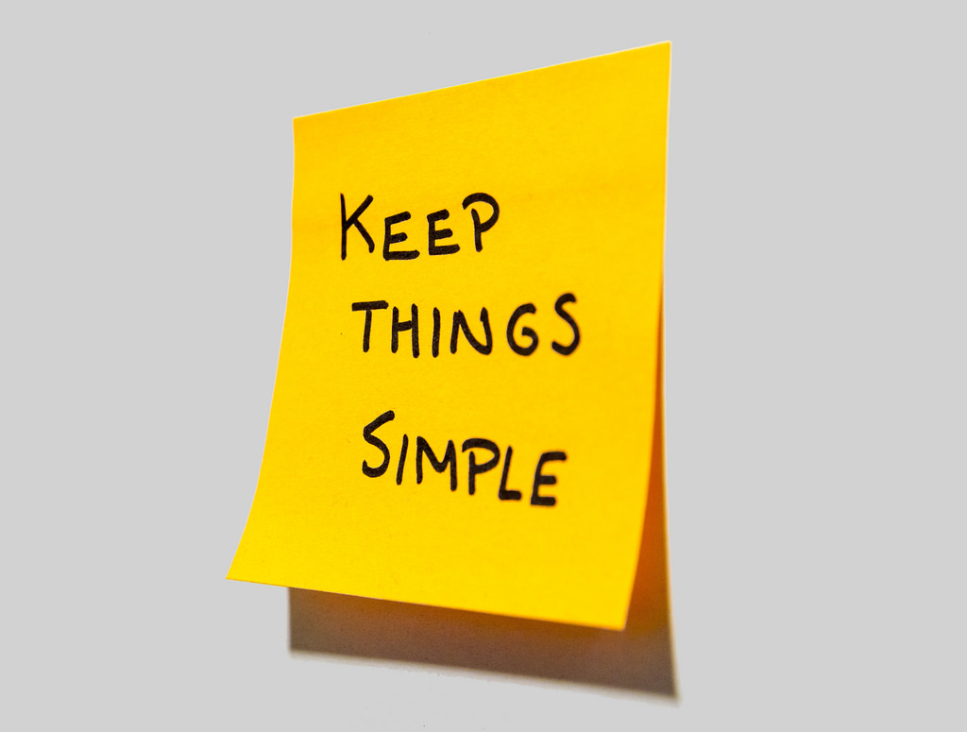

Cassie advice
Notes:
Data scientist friends, if your organization suffers from this kind of decision-maker, then I suggest sticking to the most lightweight and simple analyses to save time and money. Until the decision-makers are better trained, your showy mathematical jiu jitsu is producing nothing but dissipated heat.
<number>

Slide 25
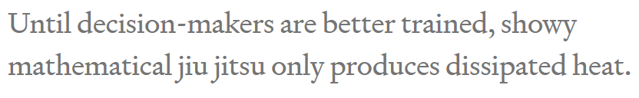

Slide 26
Problem
How to solve?
Notes:
Problem: you’re free to move the goalposts after you find out where the data landed. (Of course you score a goal every time. You’re just that good.)
<number>

Slide 27
Solution
Notes:
set the goalposts in advance and resist temptation to move them later.
Framing the decision and setting decision criteria is a science of its own
a quick fix that goes a long way is to come up with your decision boundary up front in your data science project.
resis
<number>

Slide 28

Practice
How to set goal first?

Slide 29

Solution
Notes:
she tugs at the pricetag on the back. “Hey, what does this say?” she asks me. “If it’s less than 80 bucks, I’ll buy it.”
<number>

Slide 30

Order matters
Notes:
Now that’s some decision intelligence! Instead of first seeing the price and then talking herself into a decision she’s already made, she uses the data to drive it. With a well-practiced reflex, she weighs how much she likes the dress and her budget, then sets the decision boundary, and only allows herself to see the data (price) once that’s done. She’s in the habit of using data in the right order and that’s a muscle you can exercise too.
<number>

Slide 31

Practice your data driven muscle
Notes:
People don’t always need to be data-driven and Emma knows that. She doesn’t have to make unimportant decisions that way, but she also knows that practice makes perfect. It’s much easier to build the habit on trivial decisions than to struggle when the important ones come around.
<number>

Slide 32

Negotiation 101
Notes:
I went to buy fireworks
I sticked to 80 pounds
<number>

Slide 33

What if I didn’t ?

Slide 34

Notes:
In fact, standard advice for negotiators is to think through the entire range of potential offer combinations and plan your reactions to them in advance, otherwise it’s very easy for an experienced opponent to take advantage of you. Even without all the persuasion tactics at your counterpart’s disposal, irrelevant short-term factors like your blood sugar levels, your mood, how much the other party is smiling, and whether the sun is shining can have a disproportionate effect on the deal.
<number>

Slide 35
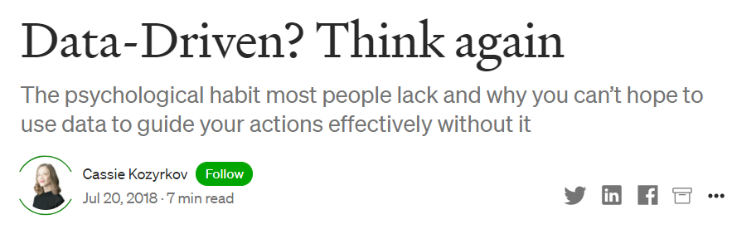

Notes:
Data-Driven? Think again. The psychological habit most people… | by Cassie Kozyrkov | HackerNoon.com | Medium
https://medium.com/hackernoon/data-inspired-5c78db3999b2
<number>

